Slide 1
Project Defence
Chung Baron

Slide 2



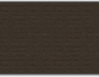
Recall
Number classification through deep learning

Slide 3
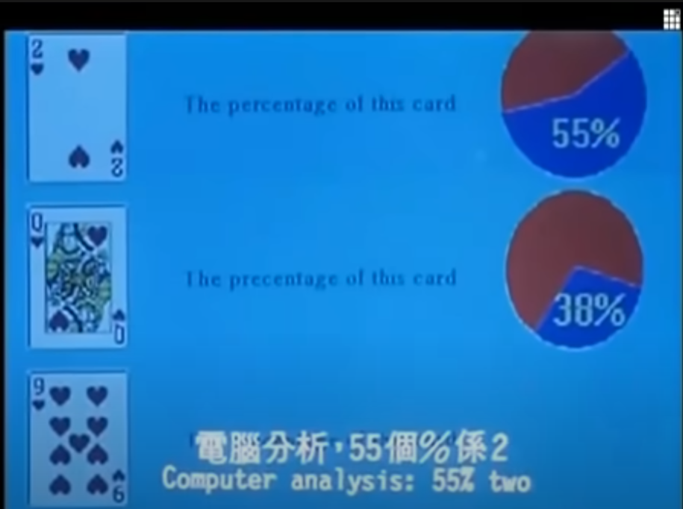
This presentation
Briefly introduce deep learning layers
Further application: Character Recognition

Slide 4
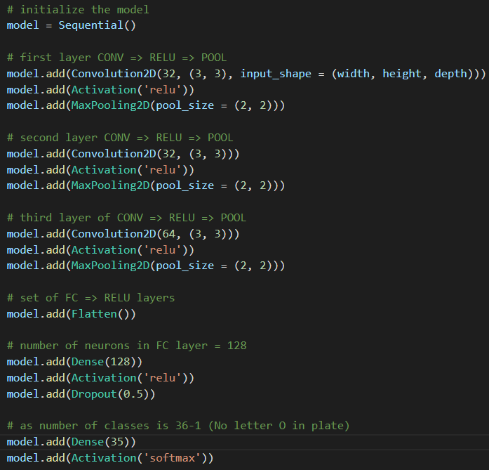

Slide 5
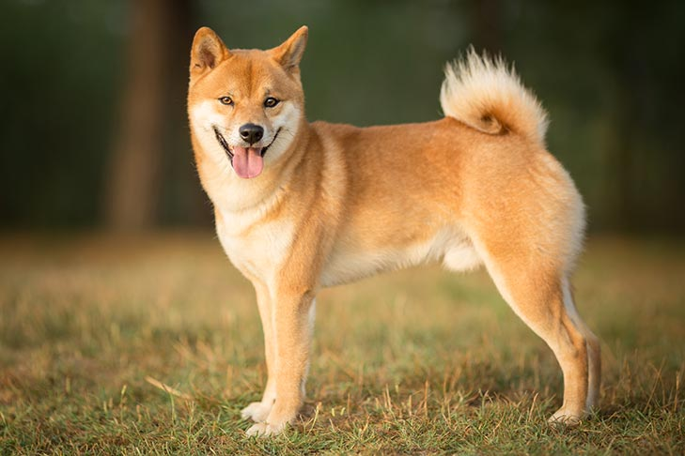
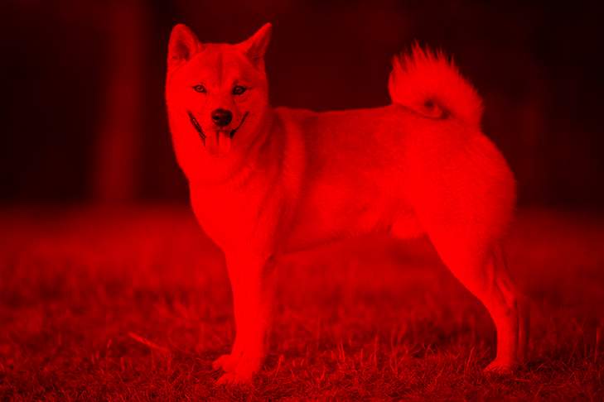
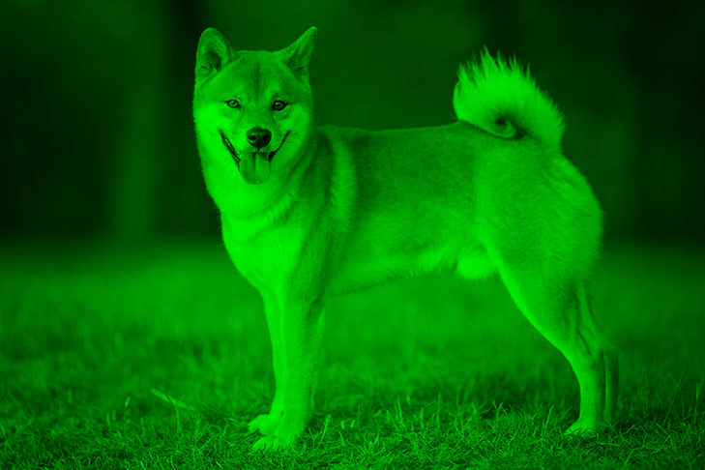
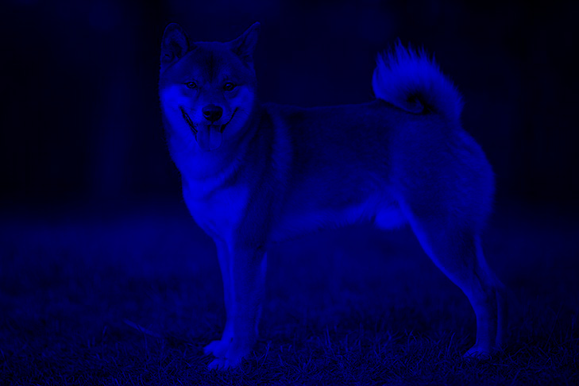
Image input

Slide 6
Flatten Layer
Cast image matrix into a very long vector
1 | -1 | 1 | 0
-4 | -5 | 1 | 5
4 | 5 | 1 | -1
-1 | 1 | 2 | 3
T
Flatten
1 | -1 | 1 | 0 | -4 | -5 | 1 | 5 | 4 | 5 | 1 | -1 | -1 | 1 | 2 | 3

Slide 7
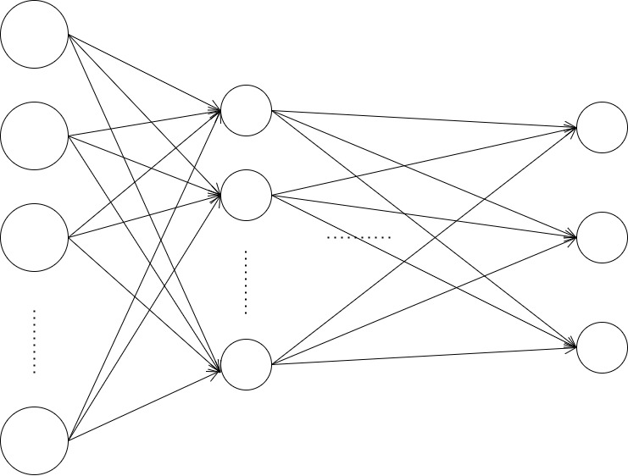
Flatten Layer
Input our image to the usual neural network (FC)
Put the flattened image here

Slide 8
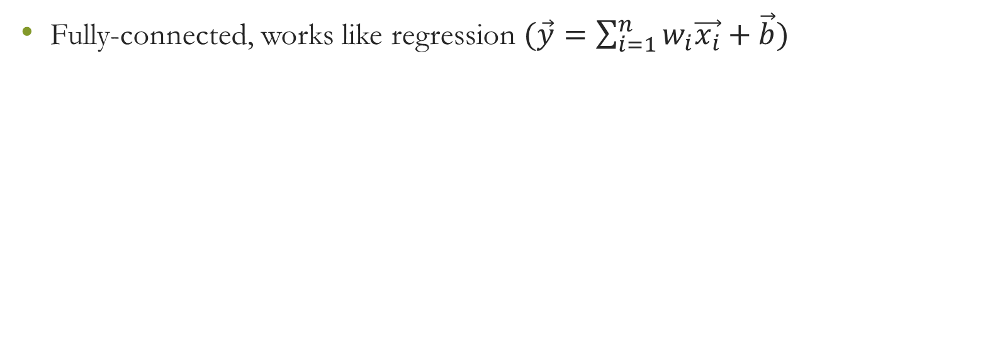
Dense Layer
Fully-connected, works like regression $(\vec{y}=\sum_{i=1}^{n}{w_{i}\vec{x_{i}}}+\vec{b})$
Dense layer
128 neuron units

Slide 9
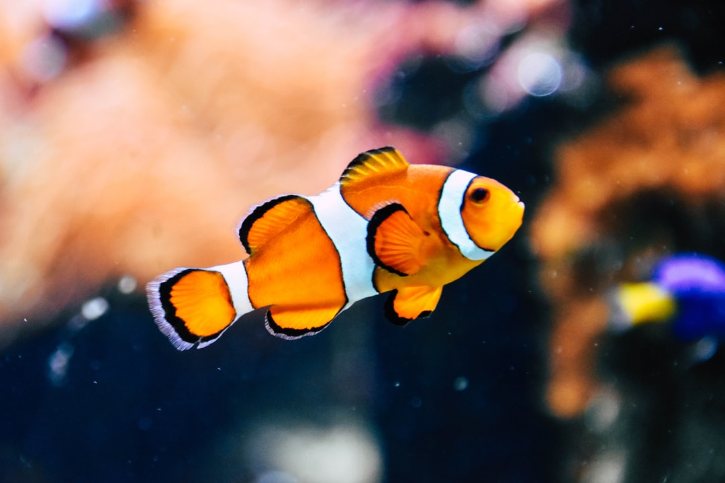
Problem of Dense Layer
To detect small patterns, we have to subdivide the photo and search for pattern
Sharing of parameters (weight) when searching

Slide 10

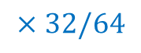
Filter
Default size: 3 (width) x 3 (height) x 3 (RGB)
To catch small patterns
$$×32/64$$

Slide 11
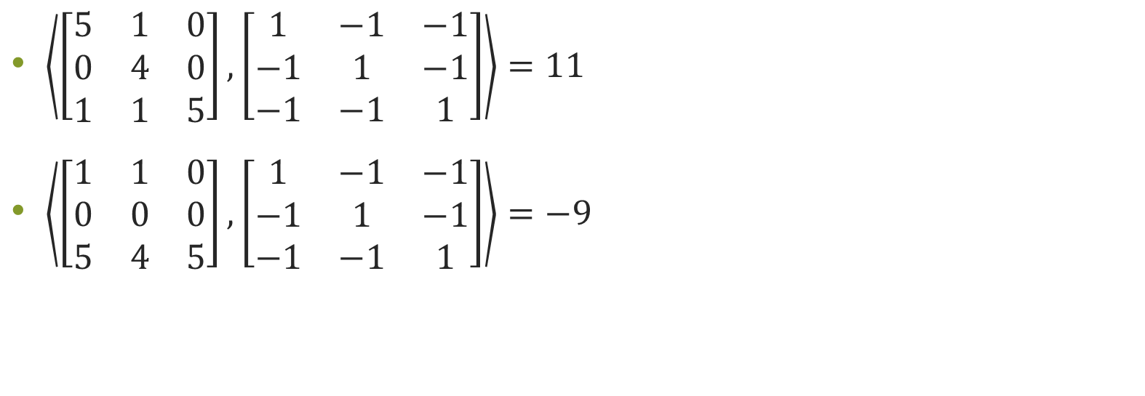
Example
$\left\langle \left[\begin{matrix}5 & 1 & 0 \\ 0 & 4 & 0 \\ 1 & 1 & 5\end{matrix}\right]\right.,\left.\left[\begin{matrix}1 & −1 & −1 \\ −1 & 1 & −1 \\ −1 & −1 & 1\end{matrix}\right]\right\rangle =11$
$\left\langle \left[\begin{matrix}1 & 1 & 0 \\ 0 & 0 & 0 \\ 5 & 4 & 5\end{matrix}\right]\right.,\left.\left[\begin{matrix}1 & −1 & −1 \\ −1 & 1 & −1 \\ −1 & −1 & 1\end{matrix}\right]\right\rangle =−9$
Image
Filter

Slide 12
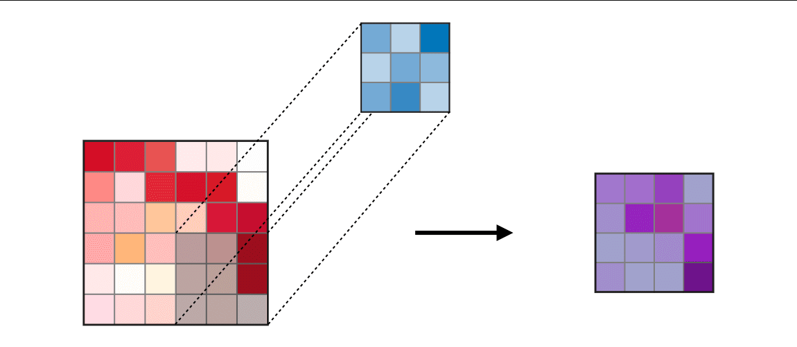
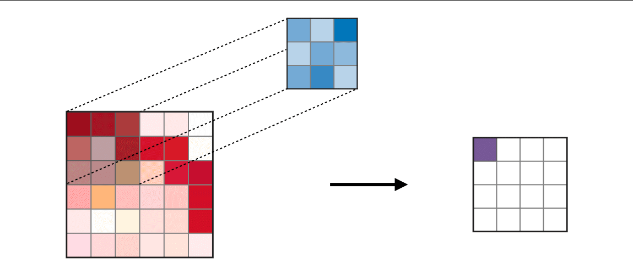
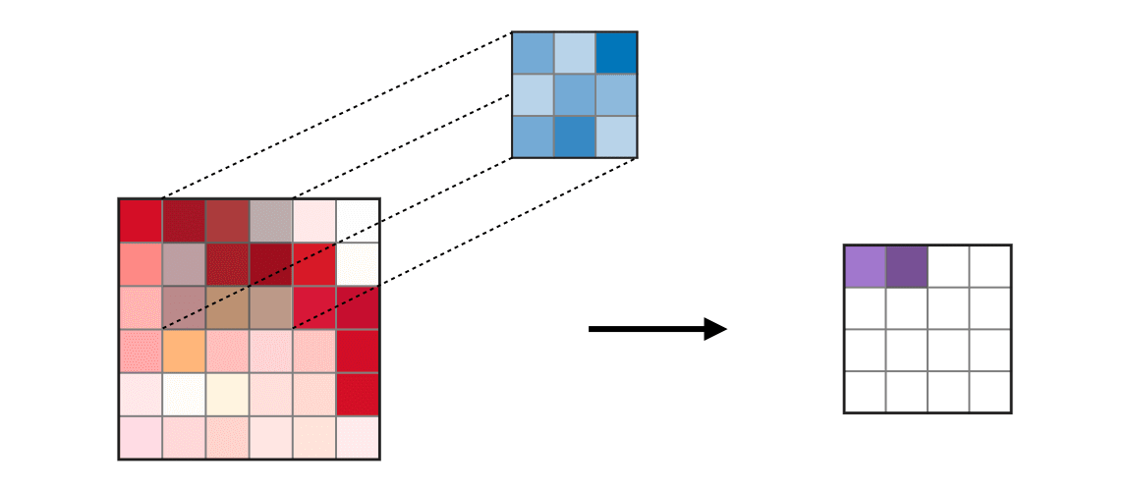
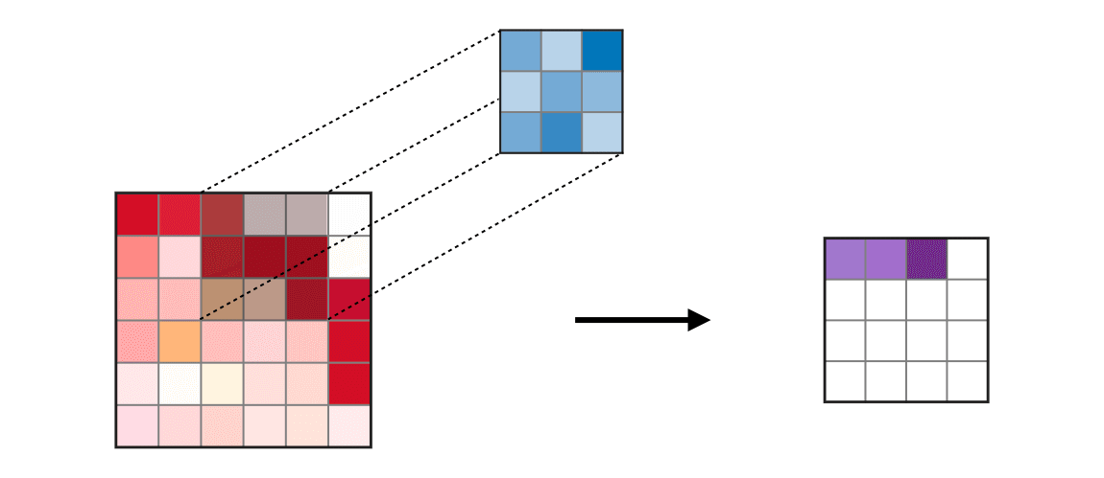
Convolution Layer

Slide 13
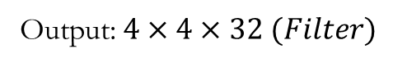
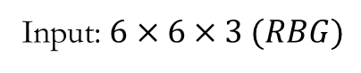
Convolution Layer
Input: $6×6×3 (RBG)$
Output: $4×4×32 (Filter)$

Slide 14

Why Conv?
As the filter convolutes over the whole image, the parameter of neurons are shared
Reduce parameter → prevents overfitting

Slide 15
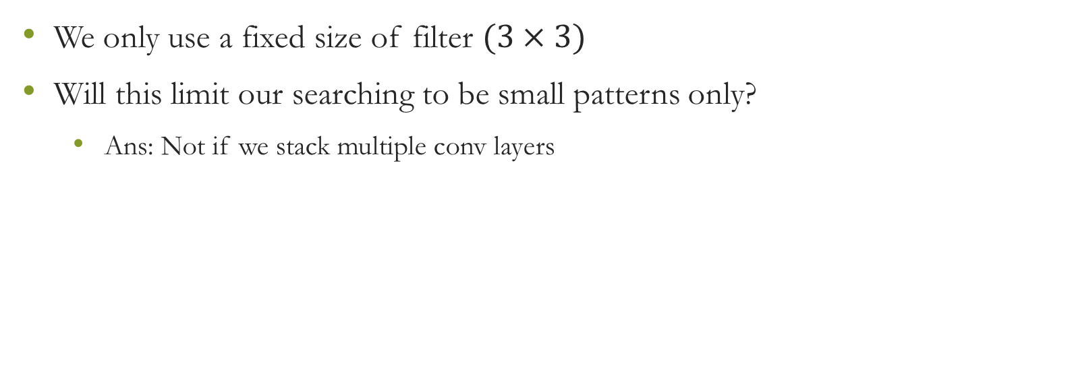
Convolution Layer
We only use a fixed size of filter $(3×3)$
Will this limit our searching to be small patterns only?
Ans: Not if we stack multiple conv layers

Slide 16
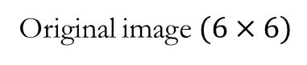
Multi-Conv Layer
Original image $(6×6)$
After 1st Conv layer

Slide 17
Activation Function
1 | -1 | 1 | 0
-4 | -5 | 1 | 5
4 | 5 | 1 | -1
-1 | 1 | 2 | 3
1 | 0 | 1 | 0
0 | 0 | 1 | 5
4 | 5 | 1 | 0
0 | 1 | 2 | 3
ReLU

Slide 18
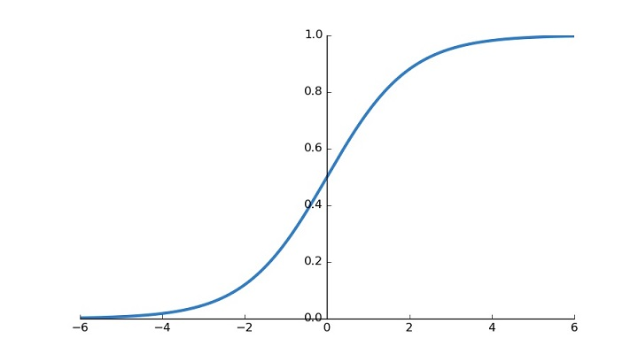
Activation Function
Graph of Softmax Function

Slide 19

Activation Function
“Cat”
“Dog”
“Horse”
“Bird”
“Fish”
Used for classification

Slide 20
MaxPool
Reduce computation
Image down-sampling “probably” does not affect its characteristics

Slide 21
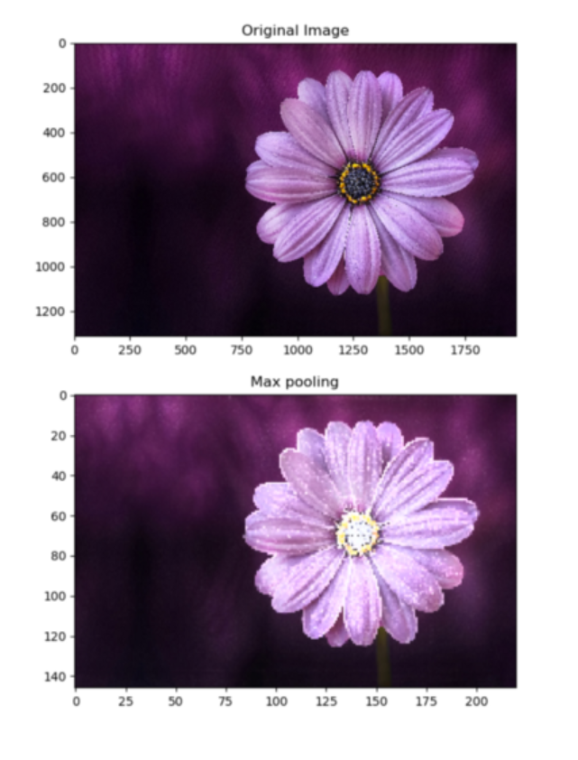
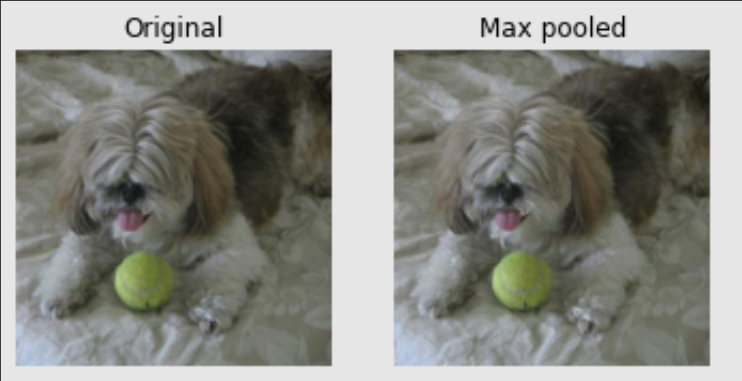

Slide 22
MaxPool
1 | -1 | 1 | 0
-4 | -5 | 1 | 5
4 | 5 | 1 | -1
-1 | 1 | 2 | 3
1 | 5
5 | 3
MaxPool

Slide 23
Dropout Layer
Randomly deletes neurons inside the network
By assigning the weight of neuron to 0
Prevents overfitting

Slide 24
The whole process
Convolution Layer
Convolution Layer
Convolution Layer
Flatten Layer
Dense Layer
Dense Layer
Softmax Activation
Input
Output
Detecting small and big patterns
“High order” “regression”

Slide 25
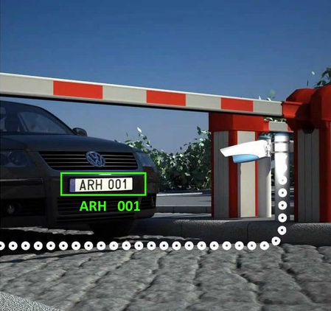
Automatic Plate Recognition System

Slide 26
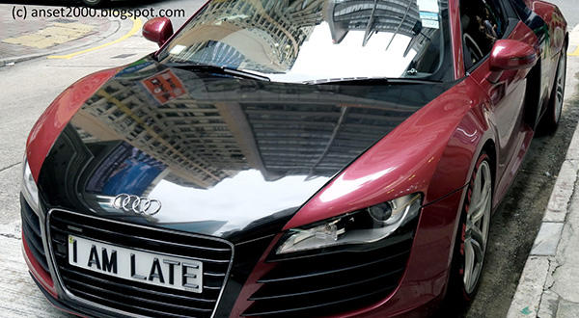
Part 1: Plate Segmentation

Slide 27
Part 2: Character Segmentation

Slide 28
Part 3: Character Recognition
Plate = “IAMLATE”

Slide 29
My Code
Focus on Part 3: Character Recognition
Labelled dataset: segmented plate character
Train the deep learning model using 4 different optimizers
ADAM, RMSProp, Momentum and SGD

Slide 30

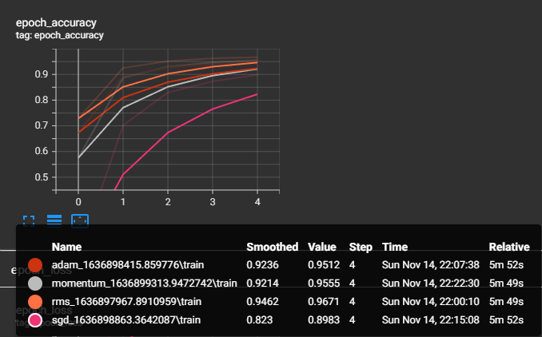
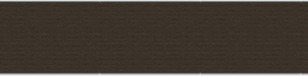
Accuracy on test dataset

Slide 31
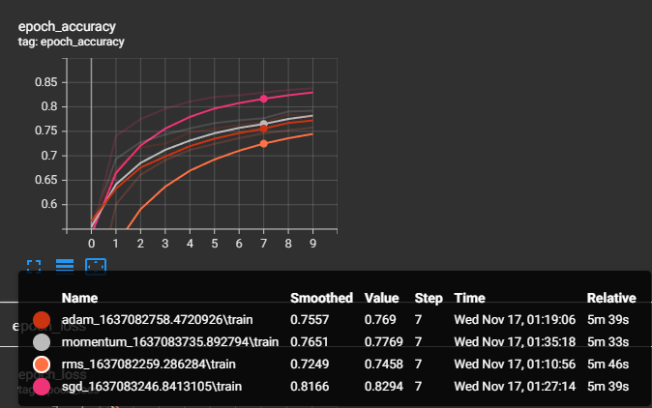
Standard Regression vs Deep Learning
Standard Regression
Deep Learning
Standard Regression

Slide 32
End of Presentation

